Slide 1

Landing
Notes:
actionButton
No alt text provided
image
No alt text provided

Slide 2
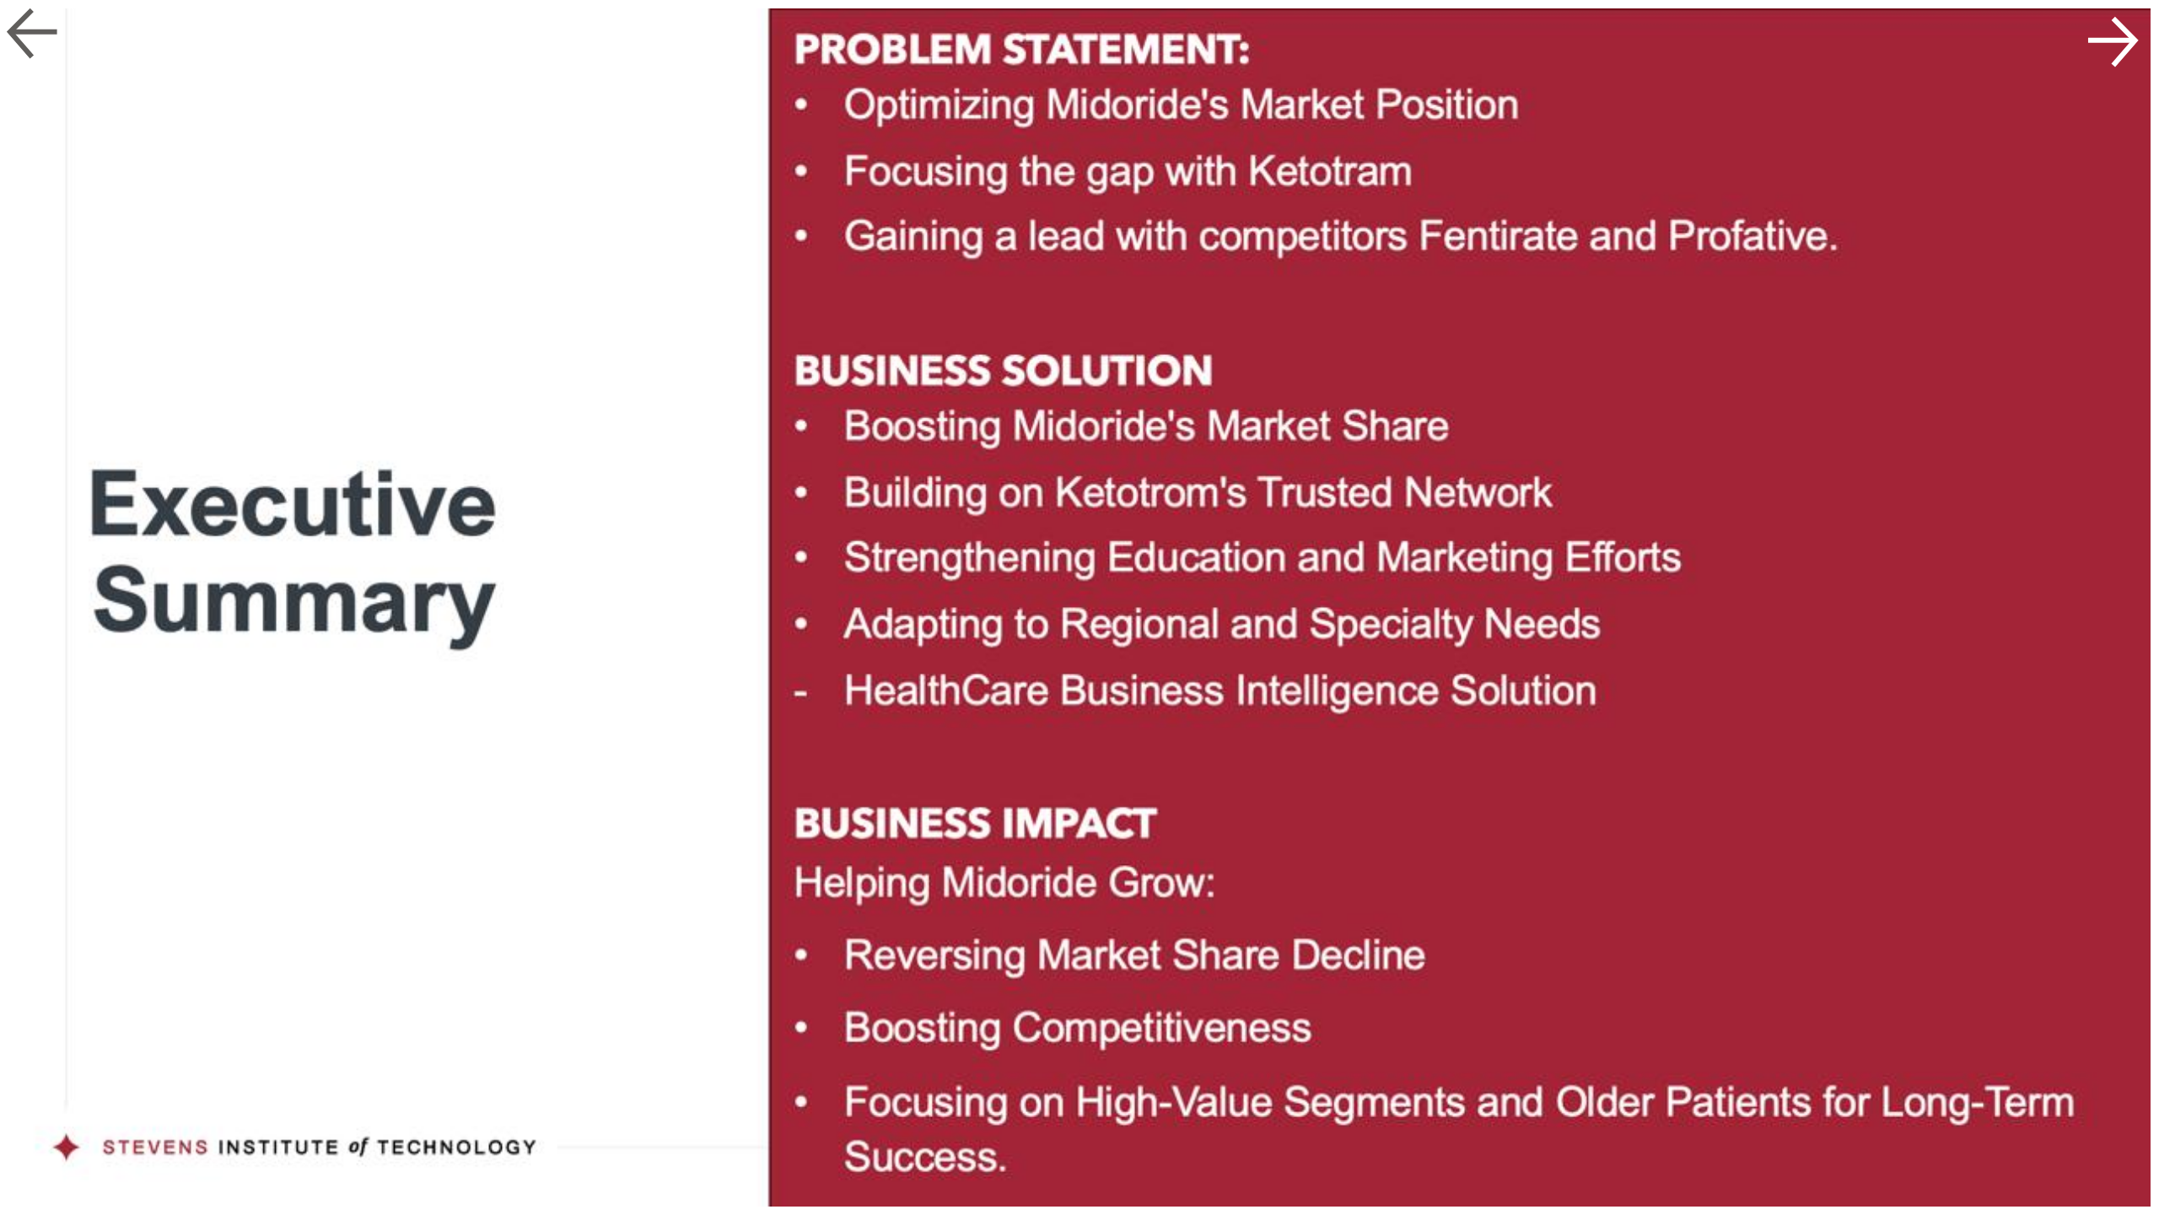
Executive Summary
Notes:
actionButton
No alt text provided
image
No alt text provided
actionButton
No alt text provided
actionButton
No alt text provided

Slide 3
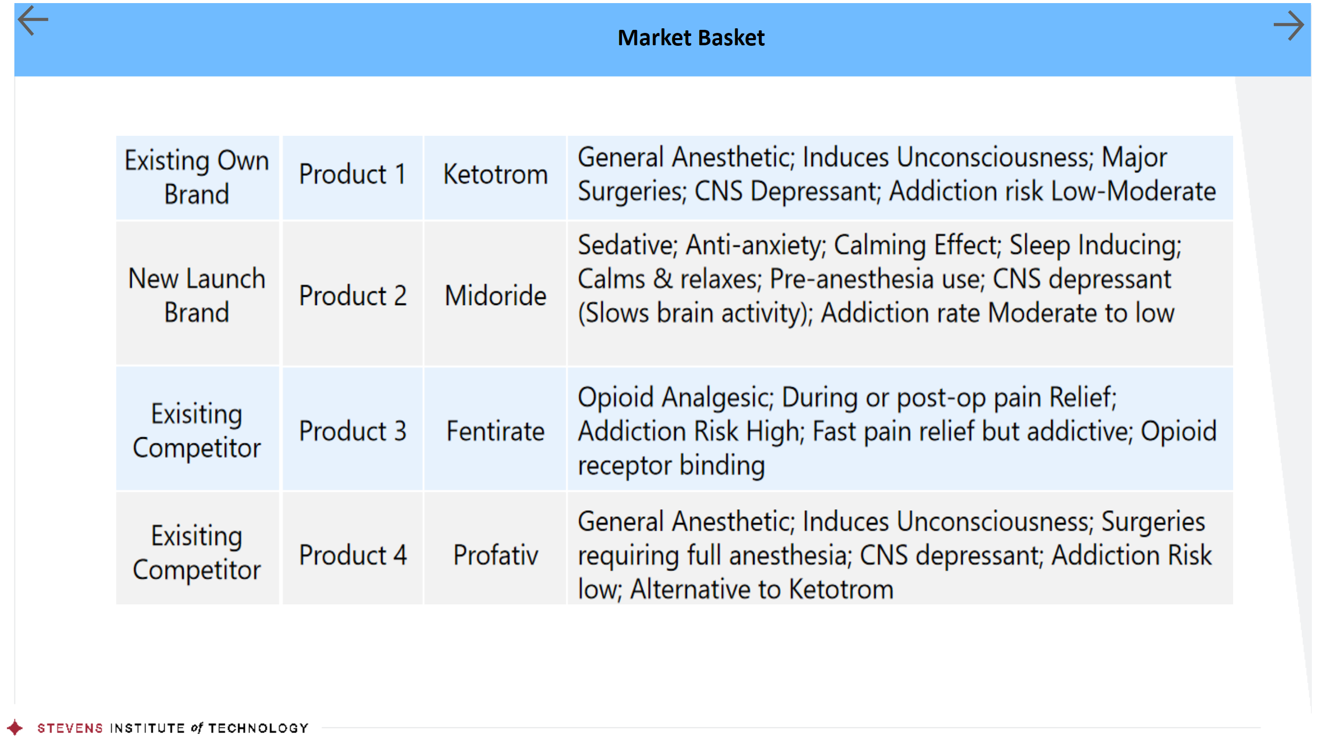
Market Basket
Notes:
actionButton
No alt text provided
actionButton
No alt text provided
actionButton
No alt text provided
image
No alt text provided
shape
No alt text provided
textbox
No alt text provided
image
No alt text provided

Slide 4
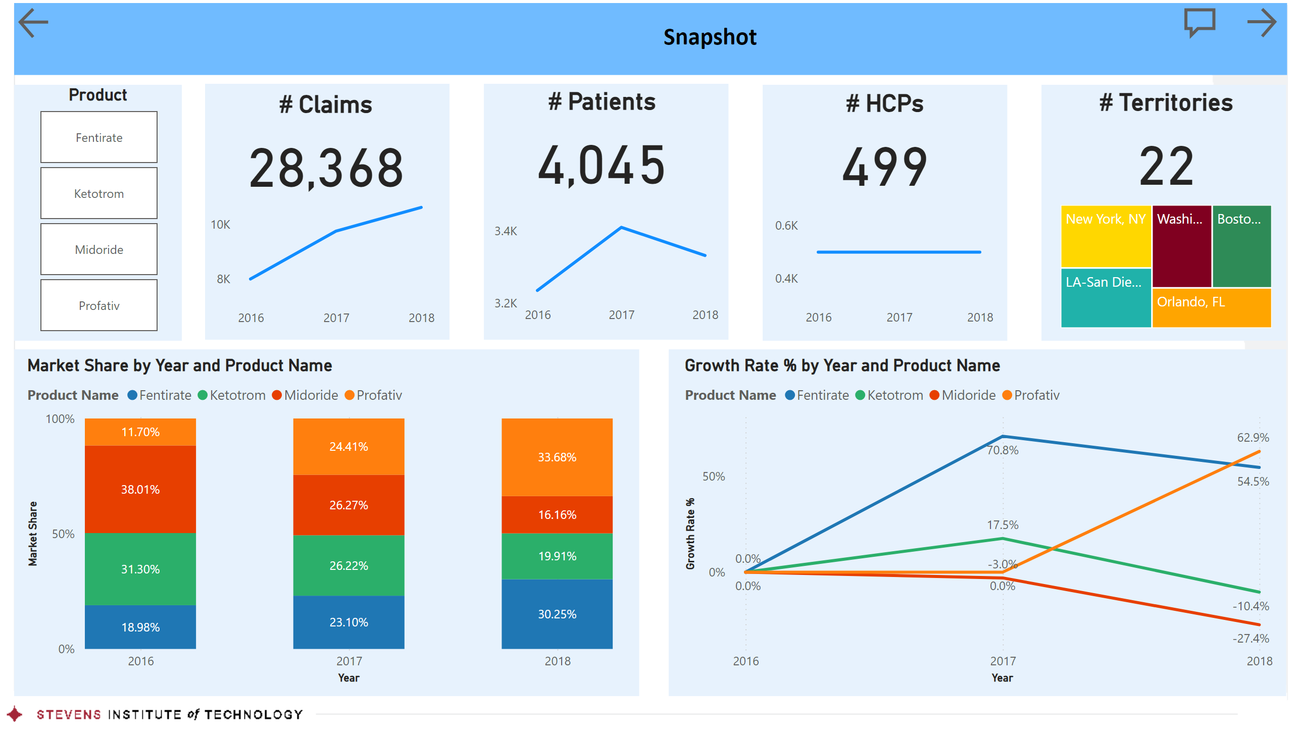
Snapshot
Notes:
actionButton
No alt text provided
textbox
No alt text provided
textbox
No alt text provided
shape
No alt text provided
shape
No alt text provided
shape
No alt text provided
# Claims
No alt text provided
Product
No alt text provided
shape
No alt text provided
lineChart
No alt text provided
# Patients
No alt text provided
lineChart
No alt text provided
shape
No alt text provided
# HCPs
No alt text provided
lineChart
No alt text provided
shape
No alt text provided
# Territories
No alt text provided
shape
No alt text provided
treemap
No alt text provided
shape
No alt text provided
hundredPercentStackedColumnChart
No alt text provided
lineChart
No alt text provided
image
No alt text provided
actionButton
No alt text provided
actionButton
No alt text provided

Slide 5
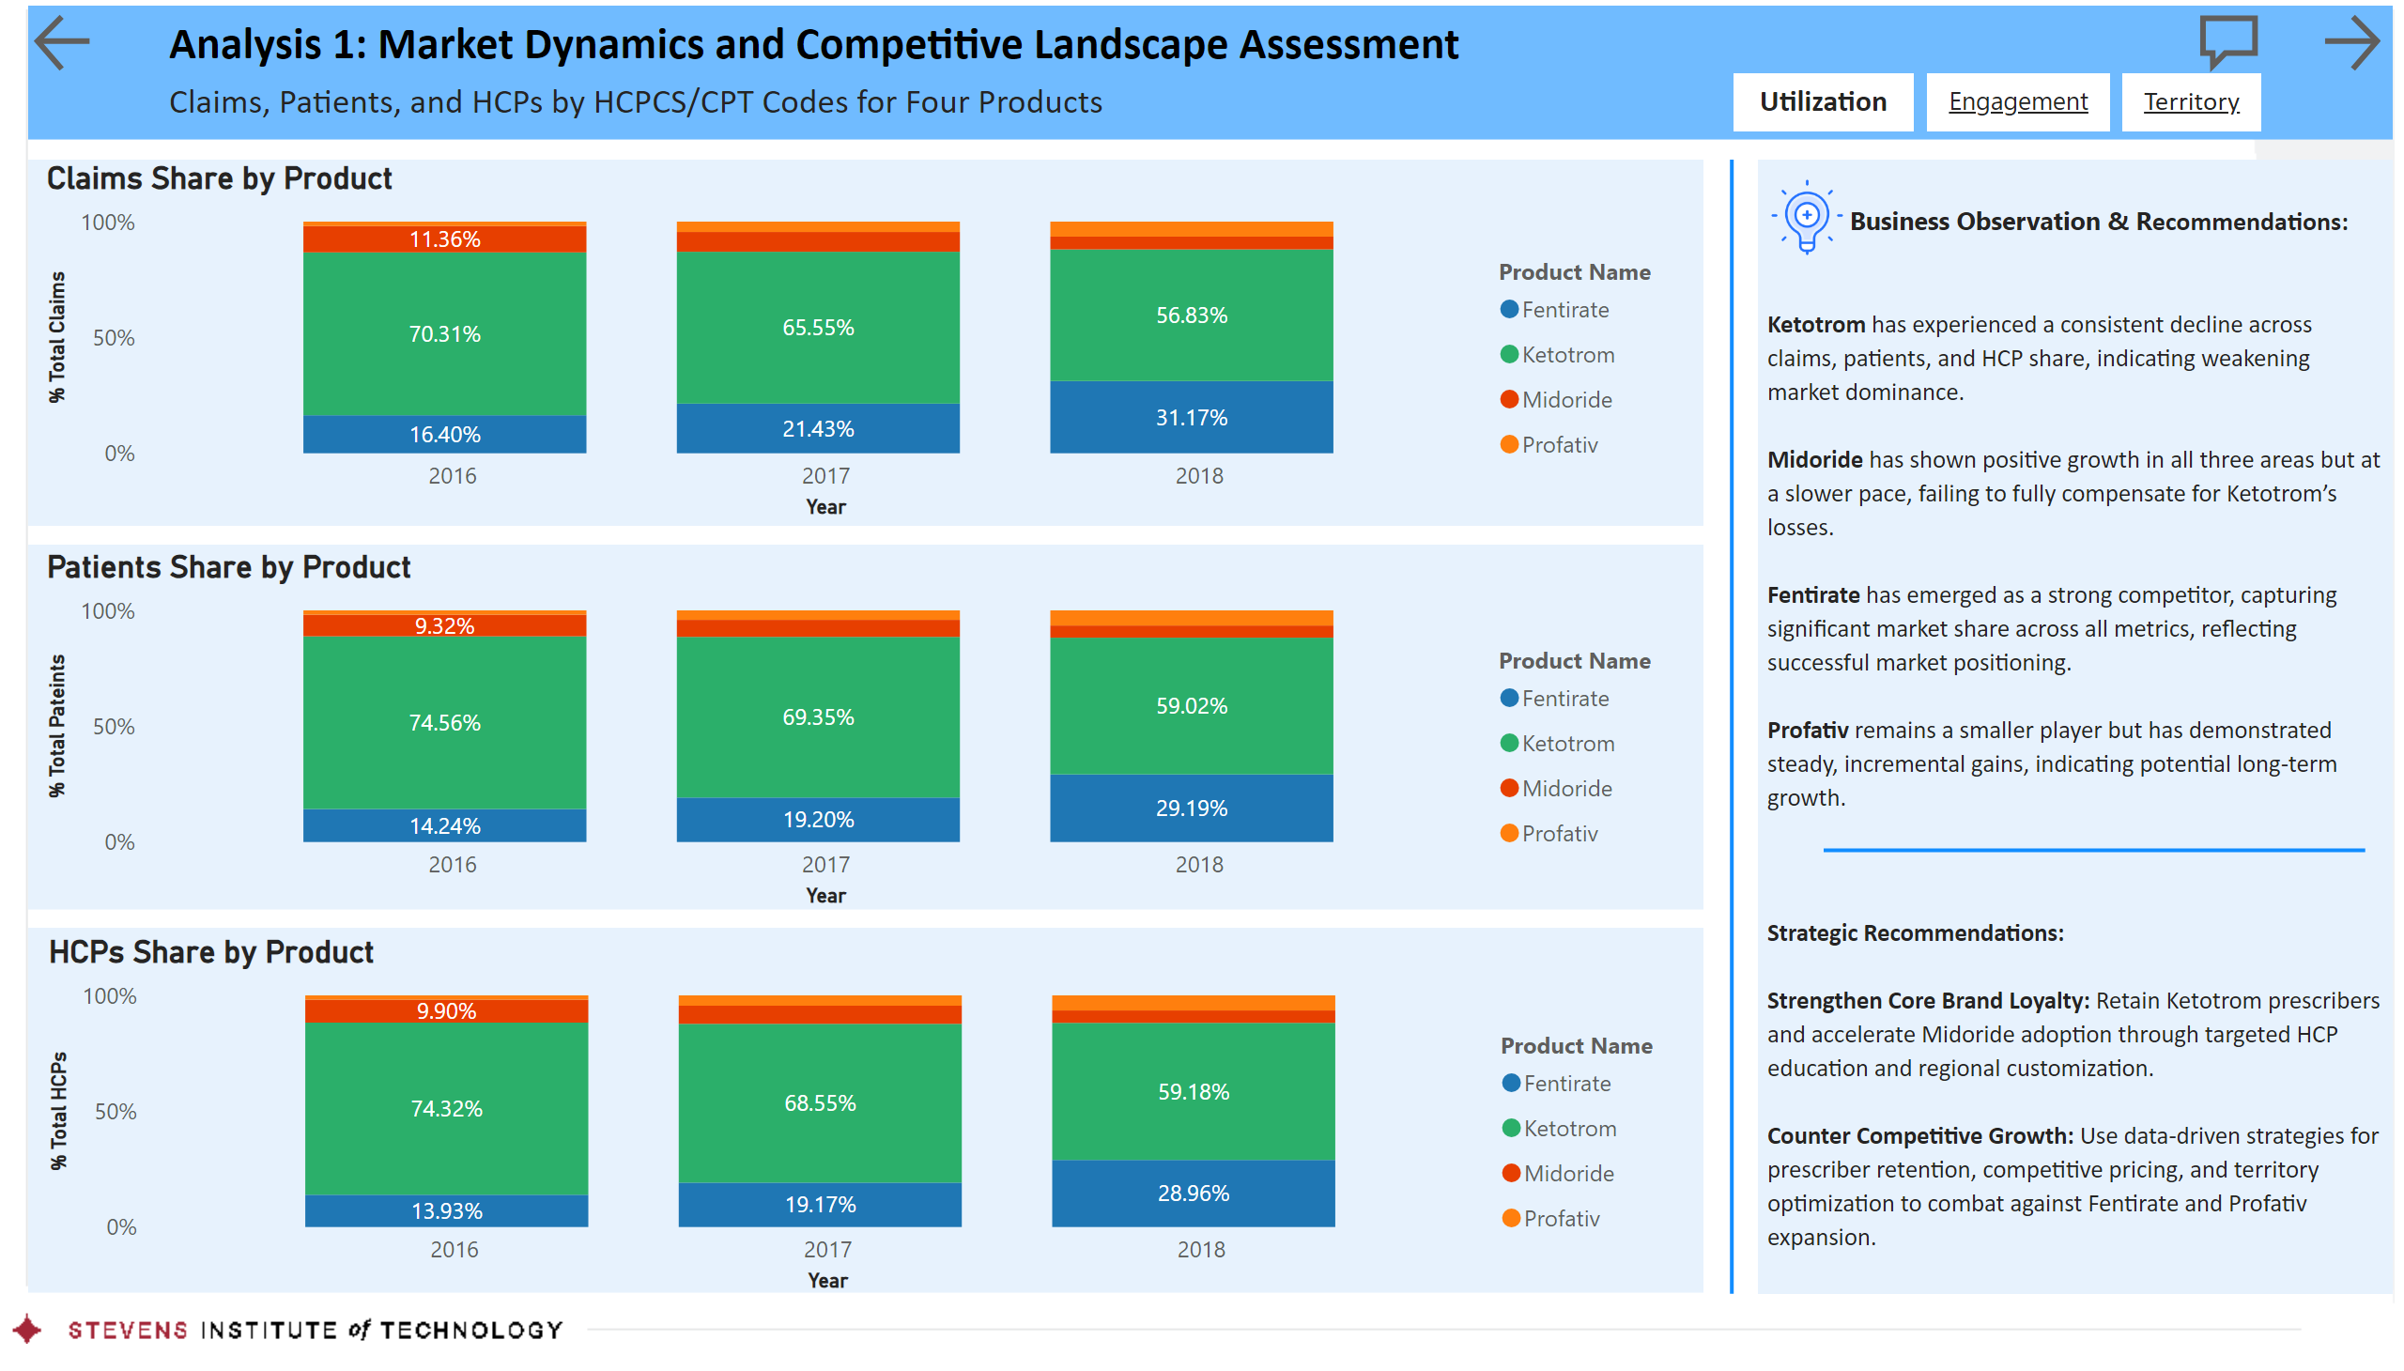
Utilization
Notes:
textbox
No alt text provided
shape
No alt text provided
textbox
No alt text provided
Claims Share by Product
No alt text provided
textbox
No alt text provided
shape
No alt text provided
shape
No alt text provided
textbox
No alt text provided
textbox
No alt text provided
textbox
No alt text provided
actionButton
No alt text provided
actionButton
No alt text provided
image
No alt text provided
image
No alt text provided
shape
No alt text provided
shape
No alt text provided
Patients Share by Product
No alt text provided
HCPs Share by Product
No alt text provided
actionButton
No alt text provided
actionButton
No alt text provided
actionButton
No alt text provided
shape
No alt text provided

Slide 6
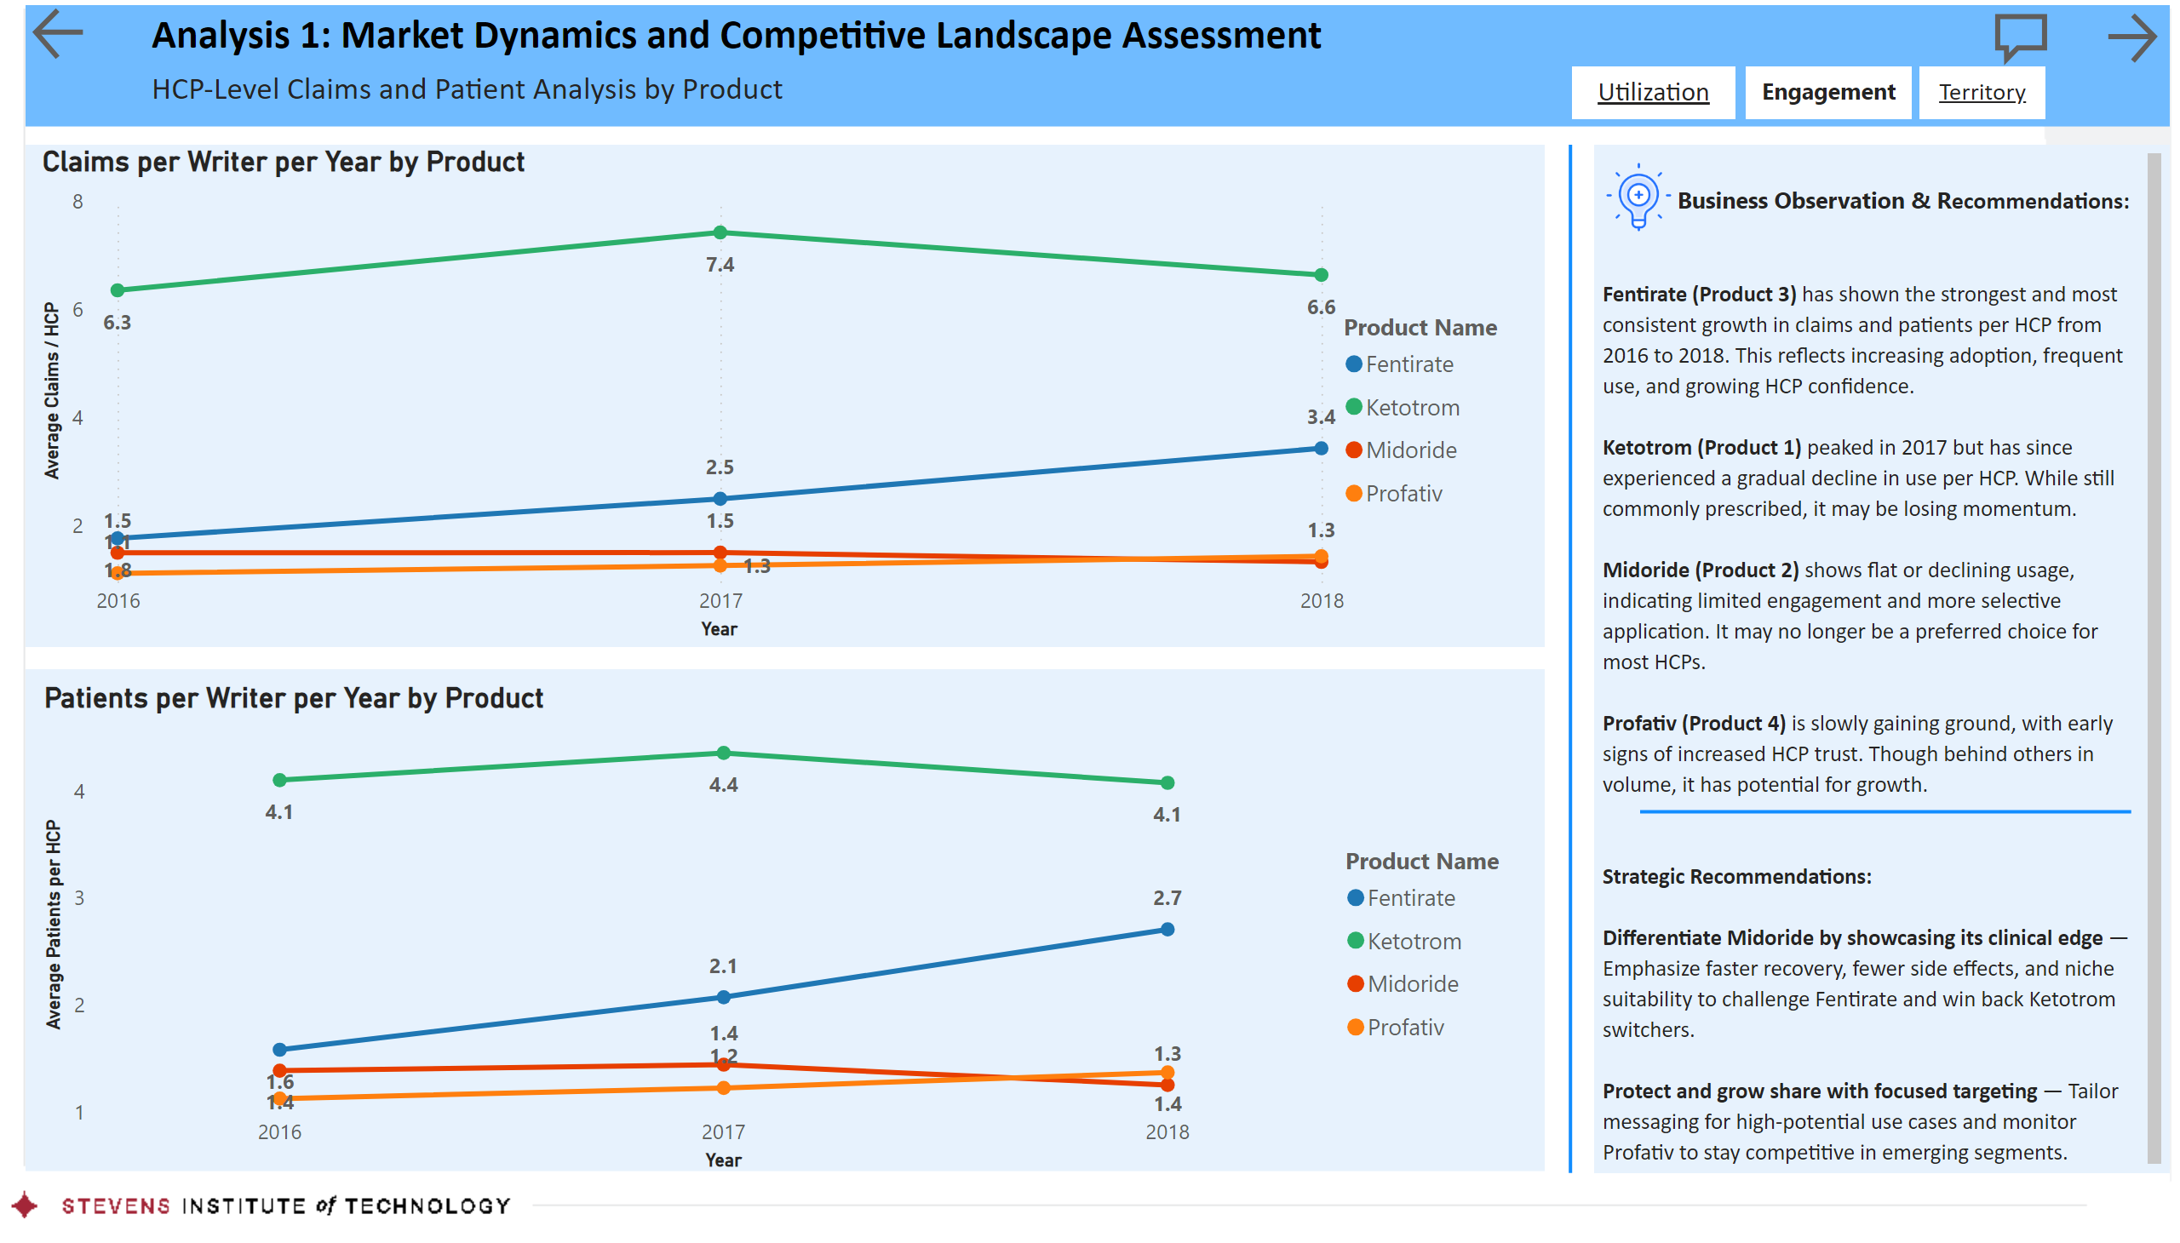
Engagement
Notes:
actionButton
No alt text provided
textbox
No alt text provided
shape
No alt text provided
textbox
No alt text provided
Claims per Writer per Year by Product
No alt text provided
shape
No alt text provided
shape
No alt text provided
textbox
No alt text provided
textbox
No alt text provided
textbox
No alt text provided
actionButton
No alt text provided
actionButton
No alt text provided
image
No alt text provided
shape
No alt text provided
Patients per Writer per Year by Product
No alt text provided
actionButton
No alt text provided
actionButton
No alt text provided
textbox
No alt text provided
image
No alt text provided
shape
No alt text provided

Slide 7
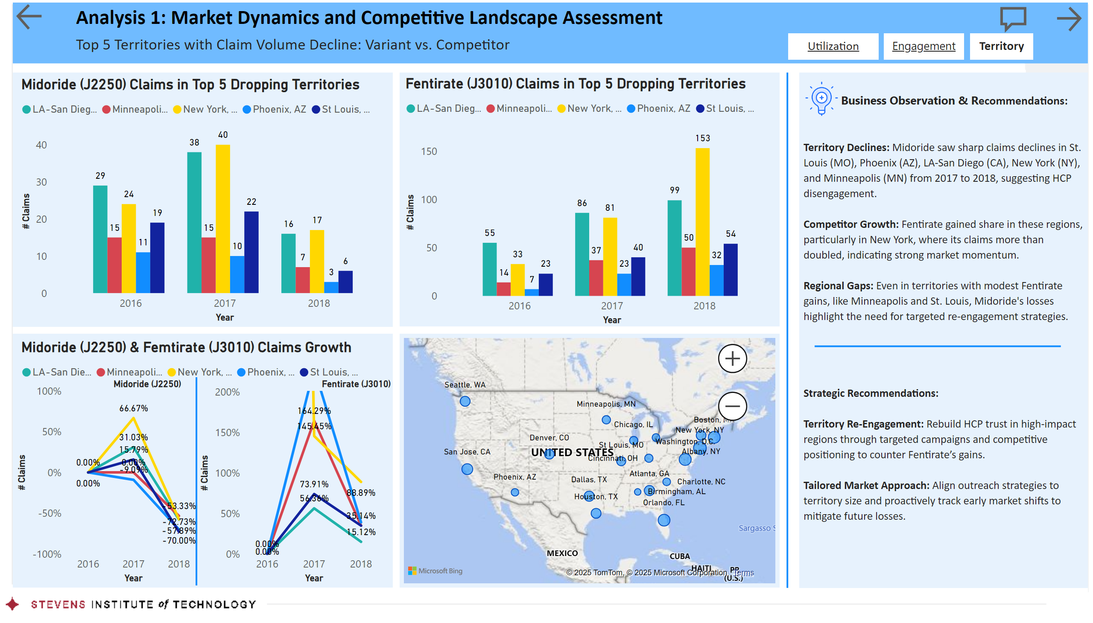
Territory
Notes:
actionButton
No alt text provided
textbox
No alt text provided
shape
No alt text provided
textbox
No alt text provided
shape
No alt text provided
shape
No alt text provided
textbox
No alt text provided
textbox
No alt text provided
textbox
No alt text provided
actionButton
No alt text provided
actionButton
No alt text provided
image
No alt text provided
shape
No alt text provided
shape
No alt text provided
shape
No alt text provided
map
No alt text provided
Midoride (J2250) Claims in Top 5 Dropping Territories
No alt text provided
Fentirate (J3010) Claims in Top 5 Dropping Territories
No alt text provided
Midoride (J2250) & Femtirate (J3010) Claims Growth
No alt text provided
Midoride (J2250) Claims in Top 5 Dropping Territories
No alt text provided
Midoride (J2250) Claims in Top 5 Dropping Territories
No alt text provided
shape
No alt text provided
textbox
No alt text provided
textbox
No alt text provided
actionButton
No alt text provided
actionButton
No alt text provided
textbox
No alt text provided
image
No alt text provided
shape
No alt text provided

Slide 8
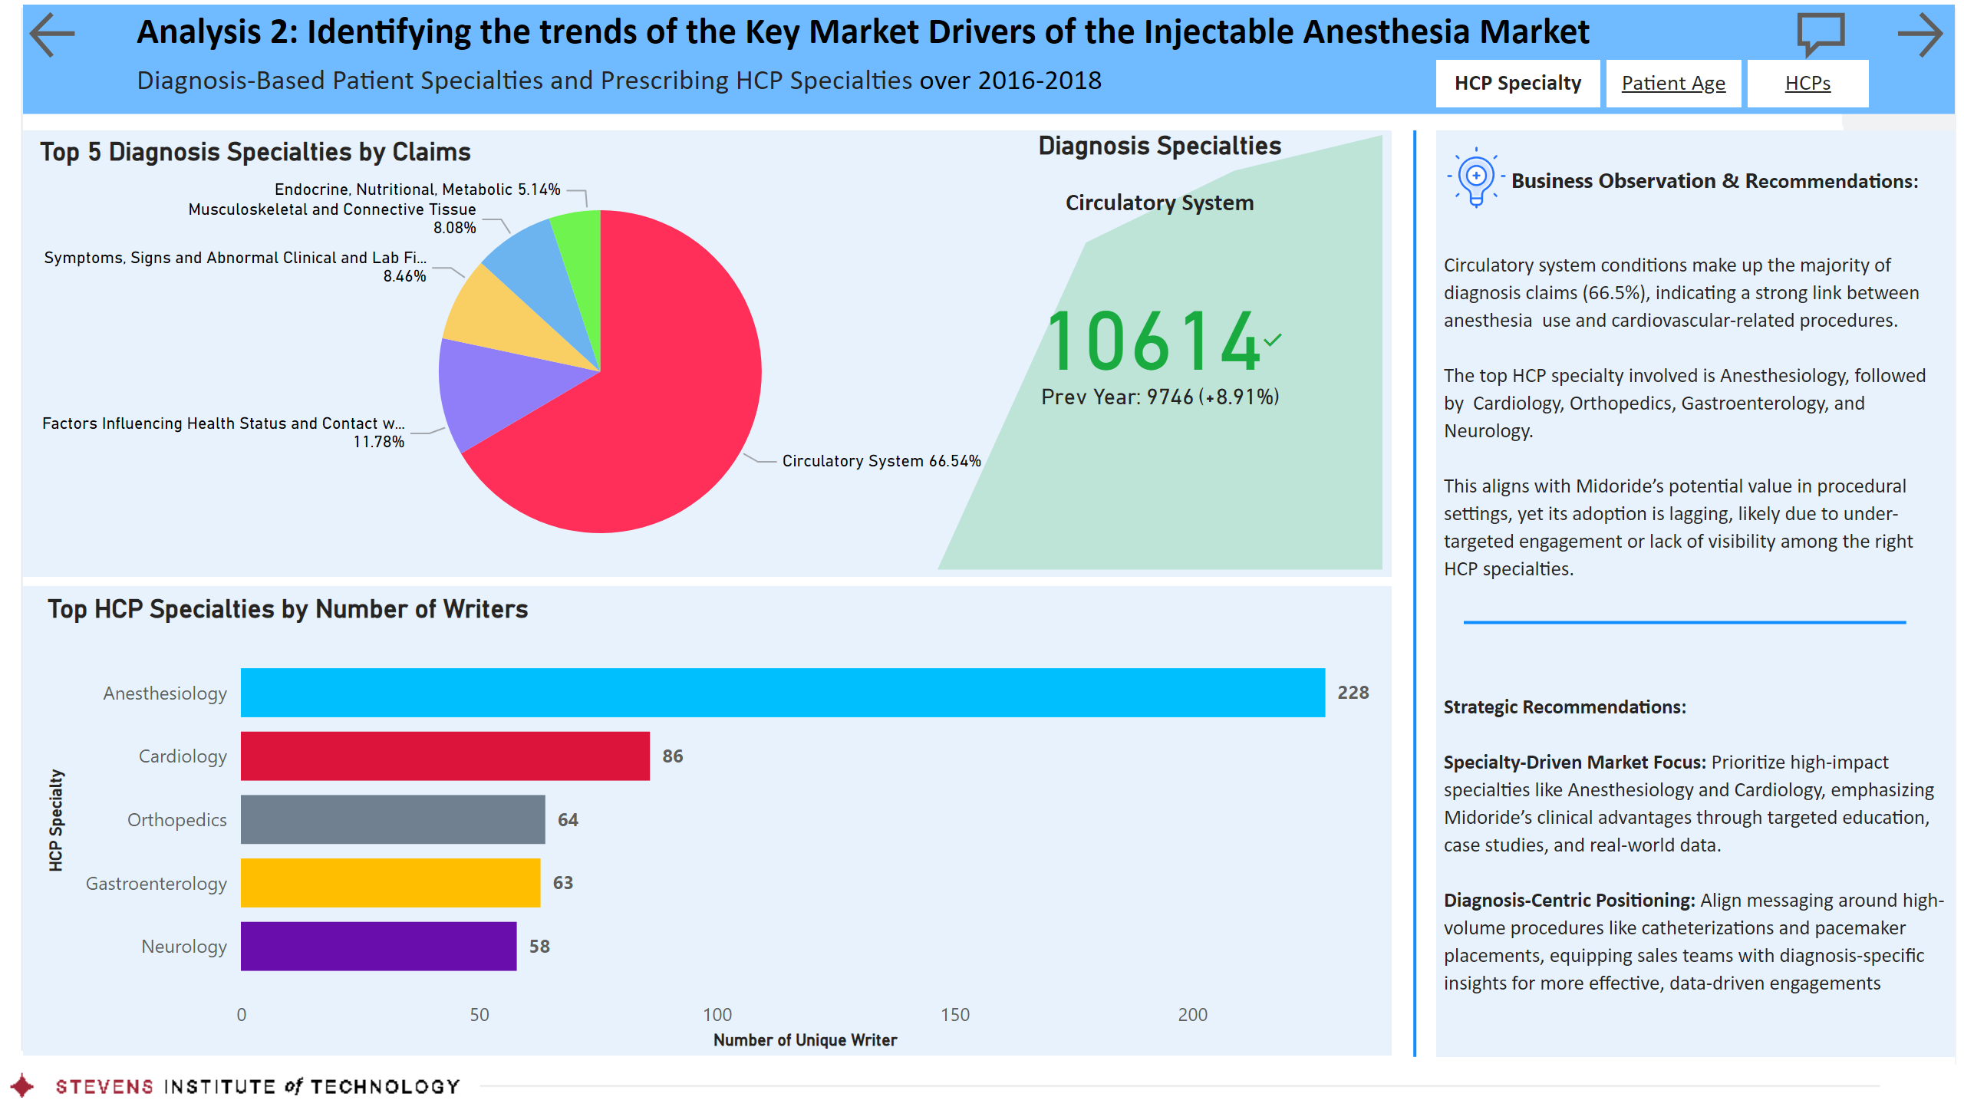
HCP Specialty
Notes:
actionButton
No alt text provided
textbox
No alt text provided
shape
No alt text provided
textbox
No alt text provided
Top 5 Diagnosis Specialties by Claims
No alt text provided
Top HCP Specialties by Number of Writers
No alt text provided
shape
No alt text provided
shape
No alt text provided
shape
No alt text provided
textbox
No alt text provided
textbox
No alt text provided
textbox
No alt text provided
actionButton
No alt text provided
actionButton
No alt text provided
image
No alt text provided
actionButton
No alt text provided
actionButton
No alt text provided
kpi
No alt text provided
Diagnosis Specialties
No alt text provided
shape
No alt text provided
image
No alt text provided
textbox
No alt text provided

Slide 9
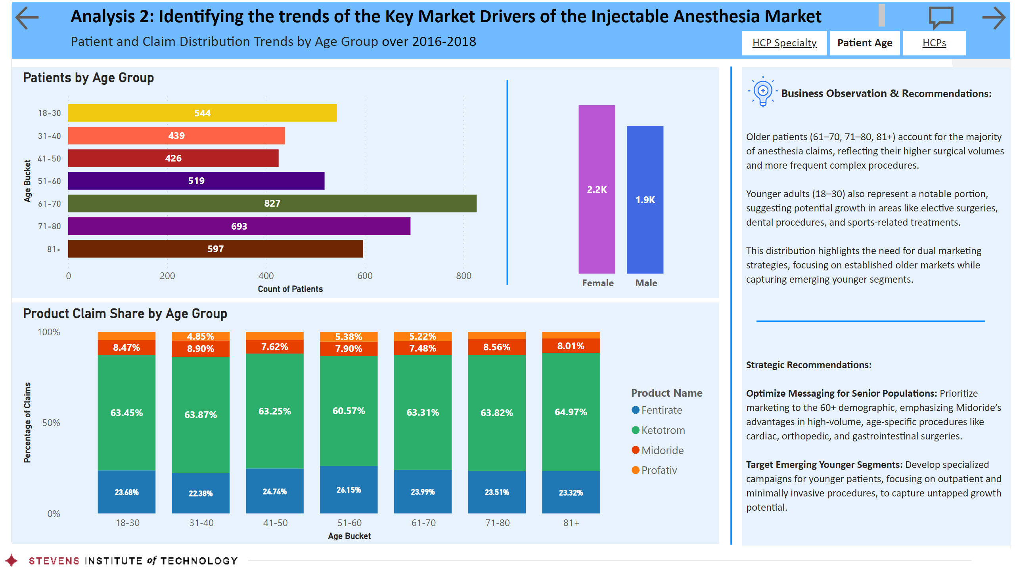
Patient Age
Notes:
actionButton
No alt text provided
textbox
No alt text provided
shape
No alt text provided
textbox
No alt text provided
Product Claim Share by Age Group
No alt text provided
shape
No alt text provided
shape
No alt text provided
shape
No alt text provided
textbox
No alt text provided
textbox
No alt text provided
textbox
No alt text provided
actionButton
No alt text provided
actionButton
No alt text provided
Patients by Age Group
No alt text provided
columnChart
No alt text provided
shape
No alt text provided
image
No alt text provided
actionButton
No alt text provided
actionButton
No alt text provided
shape
No alt text provided
image
No alt text provided
textbox
No alt text provided

Slide 10
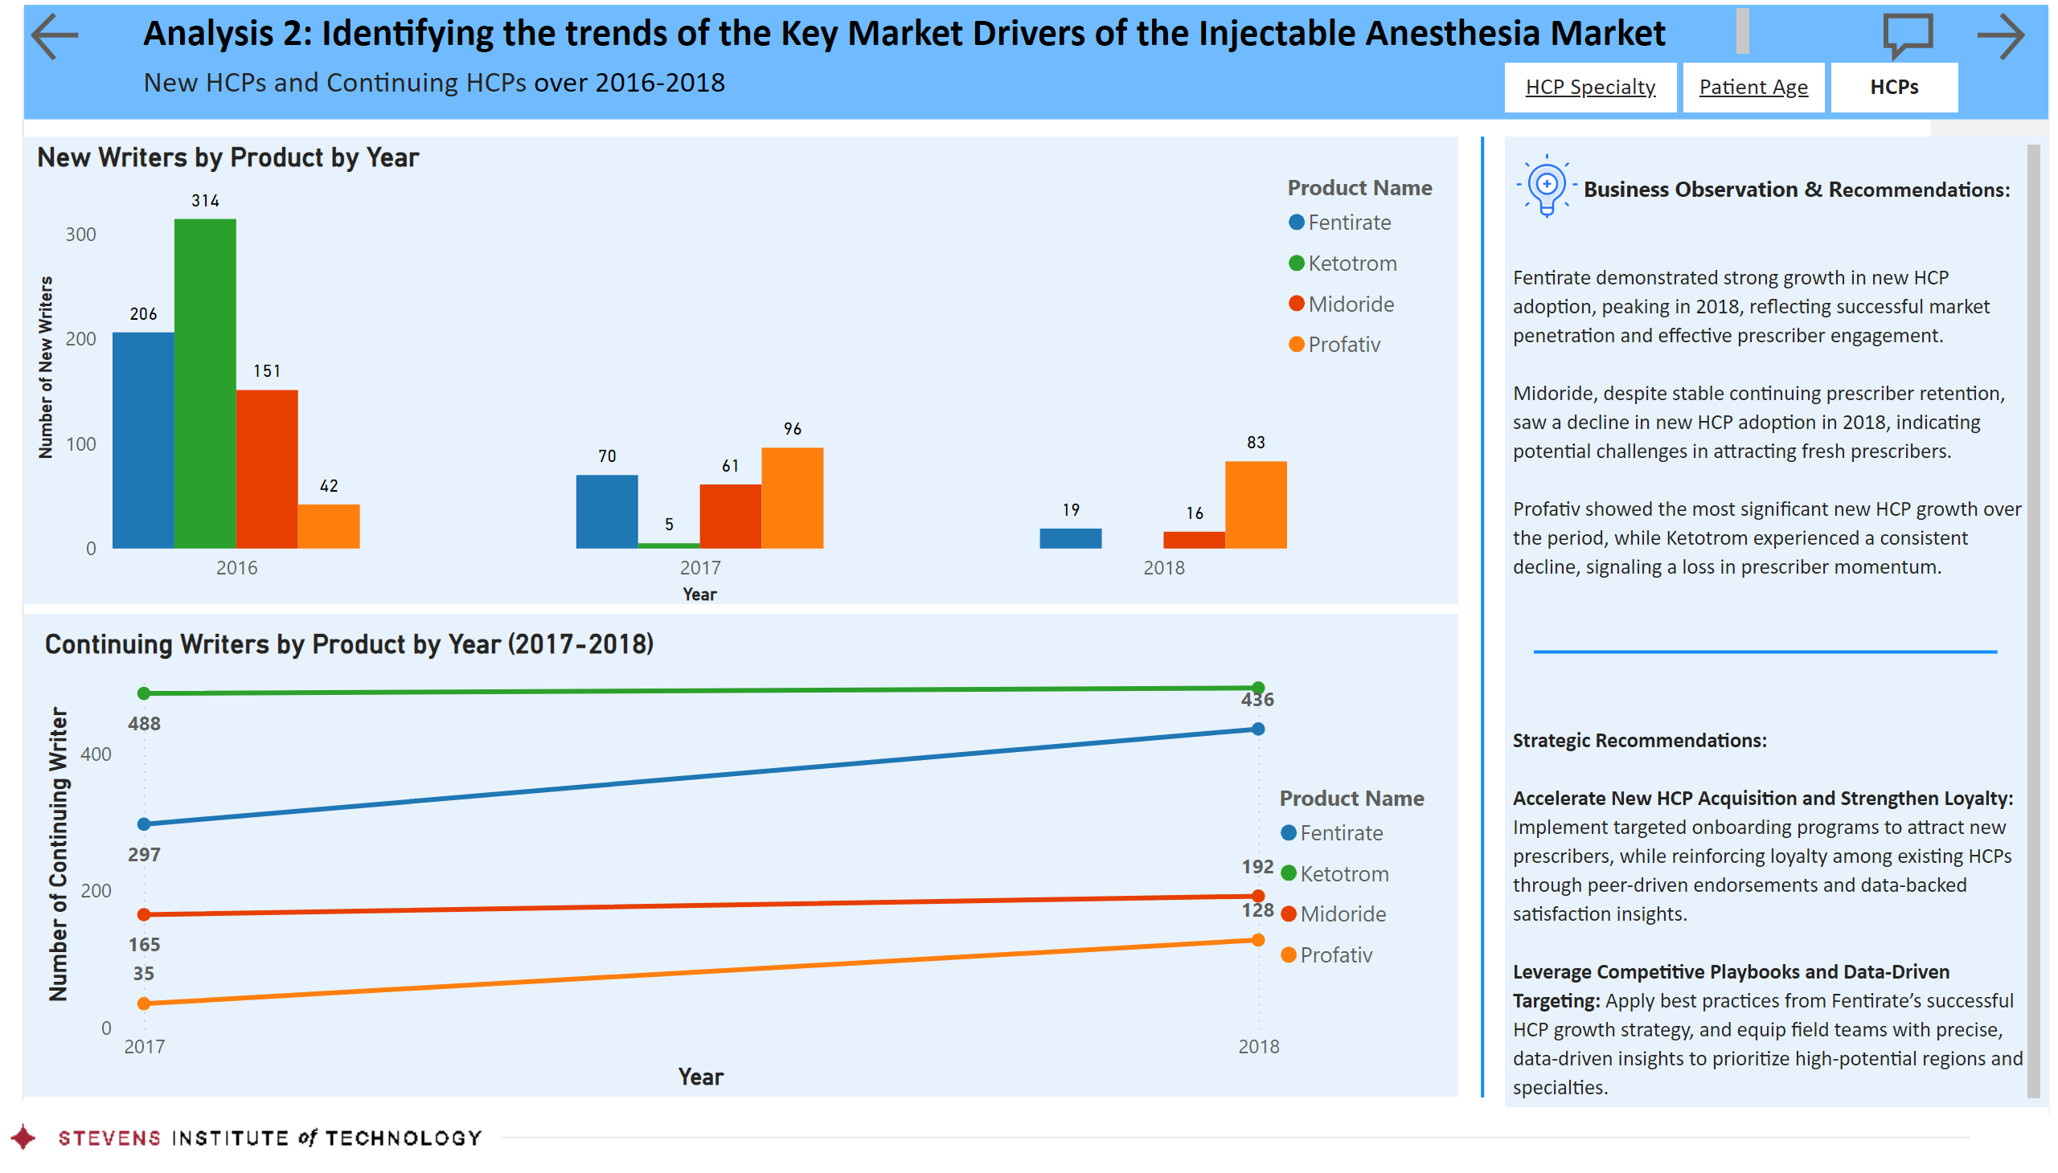
HCPs
Notes:
actionButton
No alt text provided
textbox
No alt text provided
shape
No alt text provided
textbox
No alt text provided
New Writers by Product by Year
No alt text provided
Continuing Writers by Product by Year (2017-2018)
No alt text provided
shape
No alt text provided
shape
No alt text provided
shape
No alt text provided
textbox
No alt text provided
textbox
No alt text provided
textbox
No alt text provided
actionButton
No alt text provided
actionButton
No alt text provided
image
No alt text provided
actionButton
No alt text provided
actionButton
No alt text provided
image
No alt text provided
textbox
No alt text provided
shape
No alt text provided

Slide 11
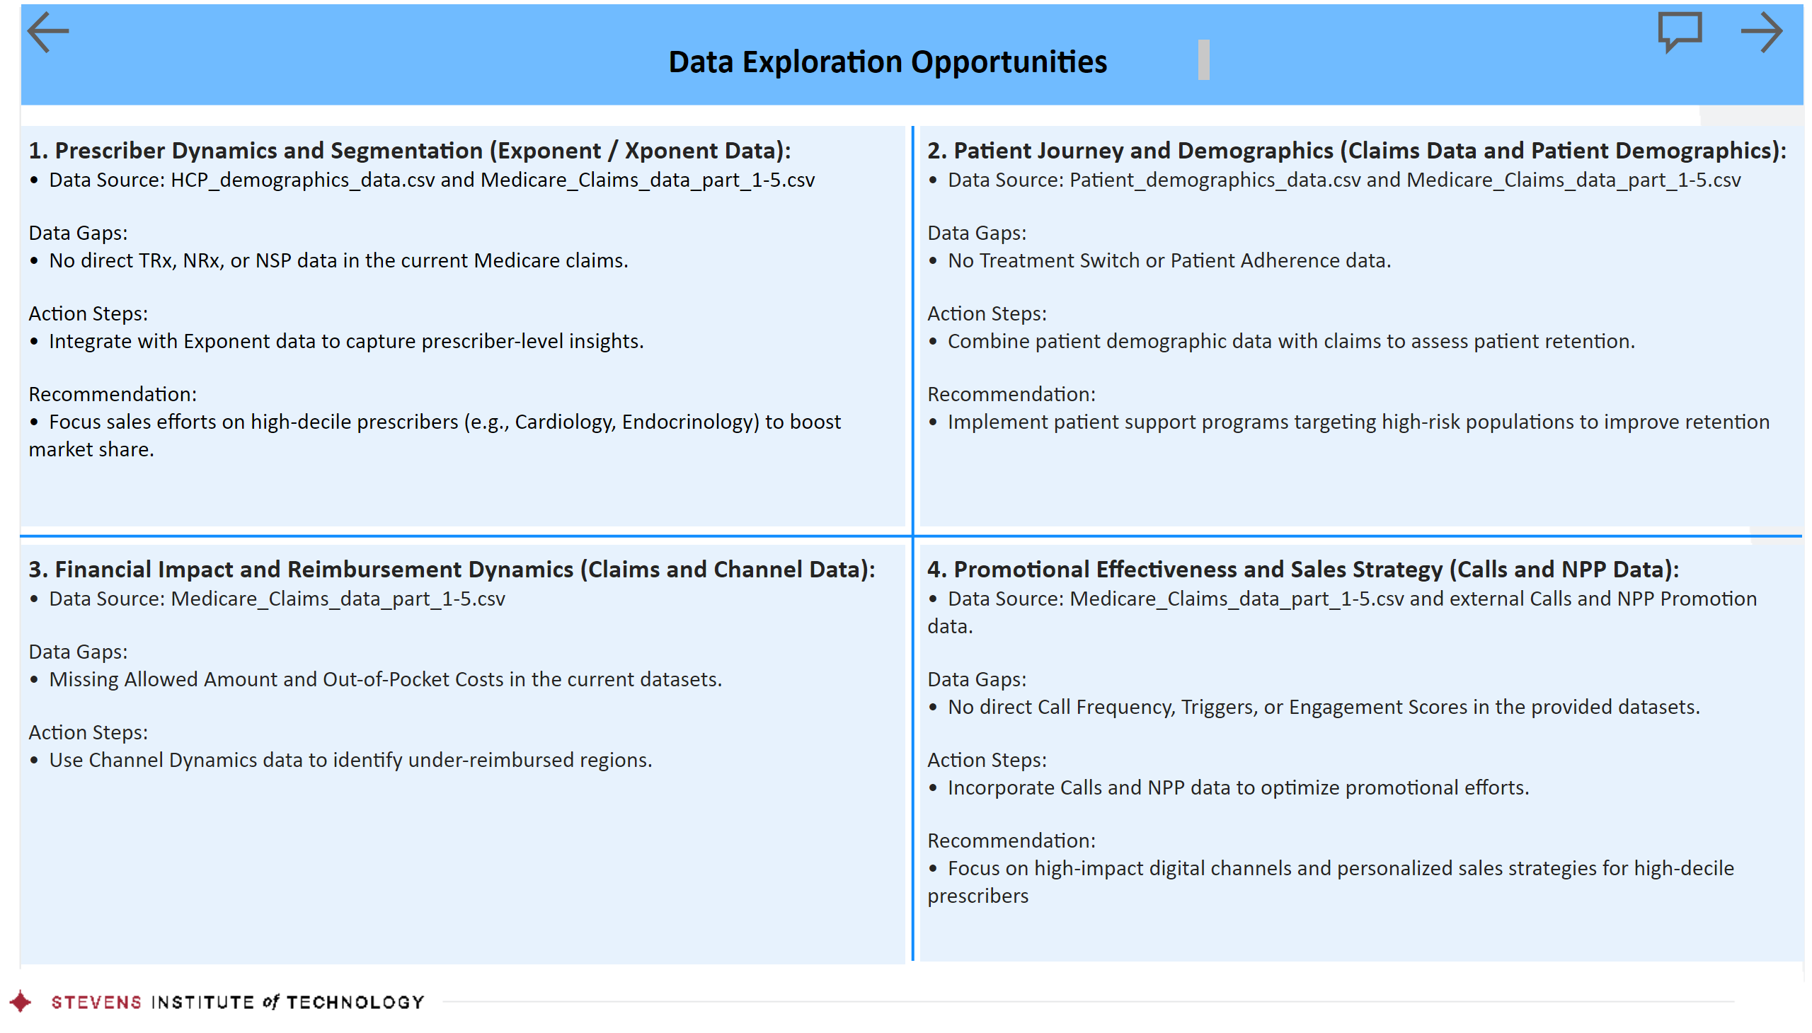
Data Opp
Notes:
actionButton
No alt text provided
textbox
No alt text provided
shape
No alt text provided
image
No alt text provided
actionButton
No alt text provided
actionButton
No alt text provided
textbox
No alt text provided
textbox
No alt text provided
textbox
No alt text provided
textbox
No alt text provided
shape
No alt text provided
shape
No alt text provided

Slide 12
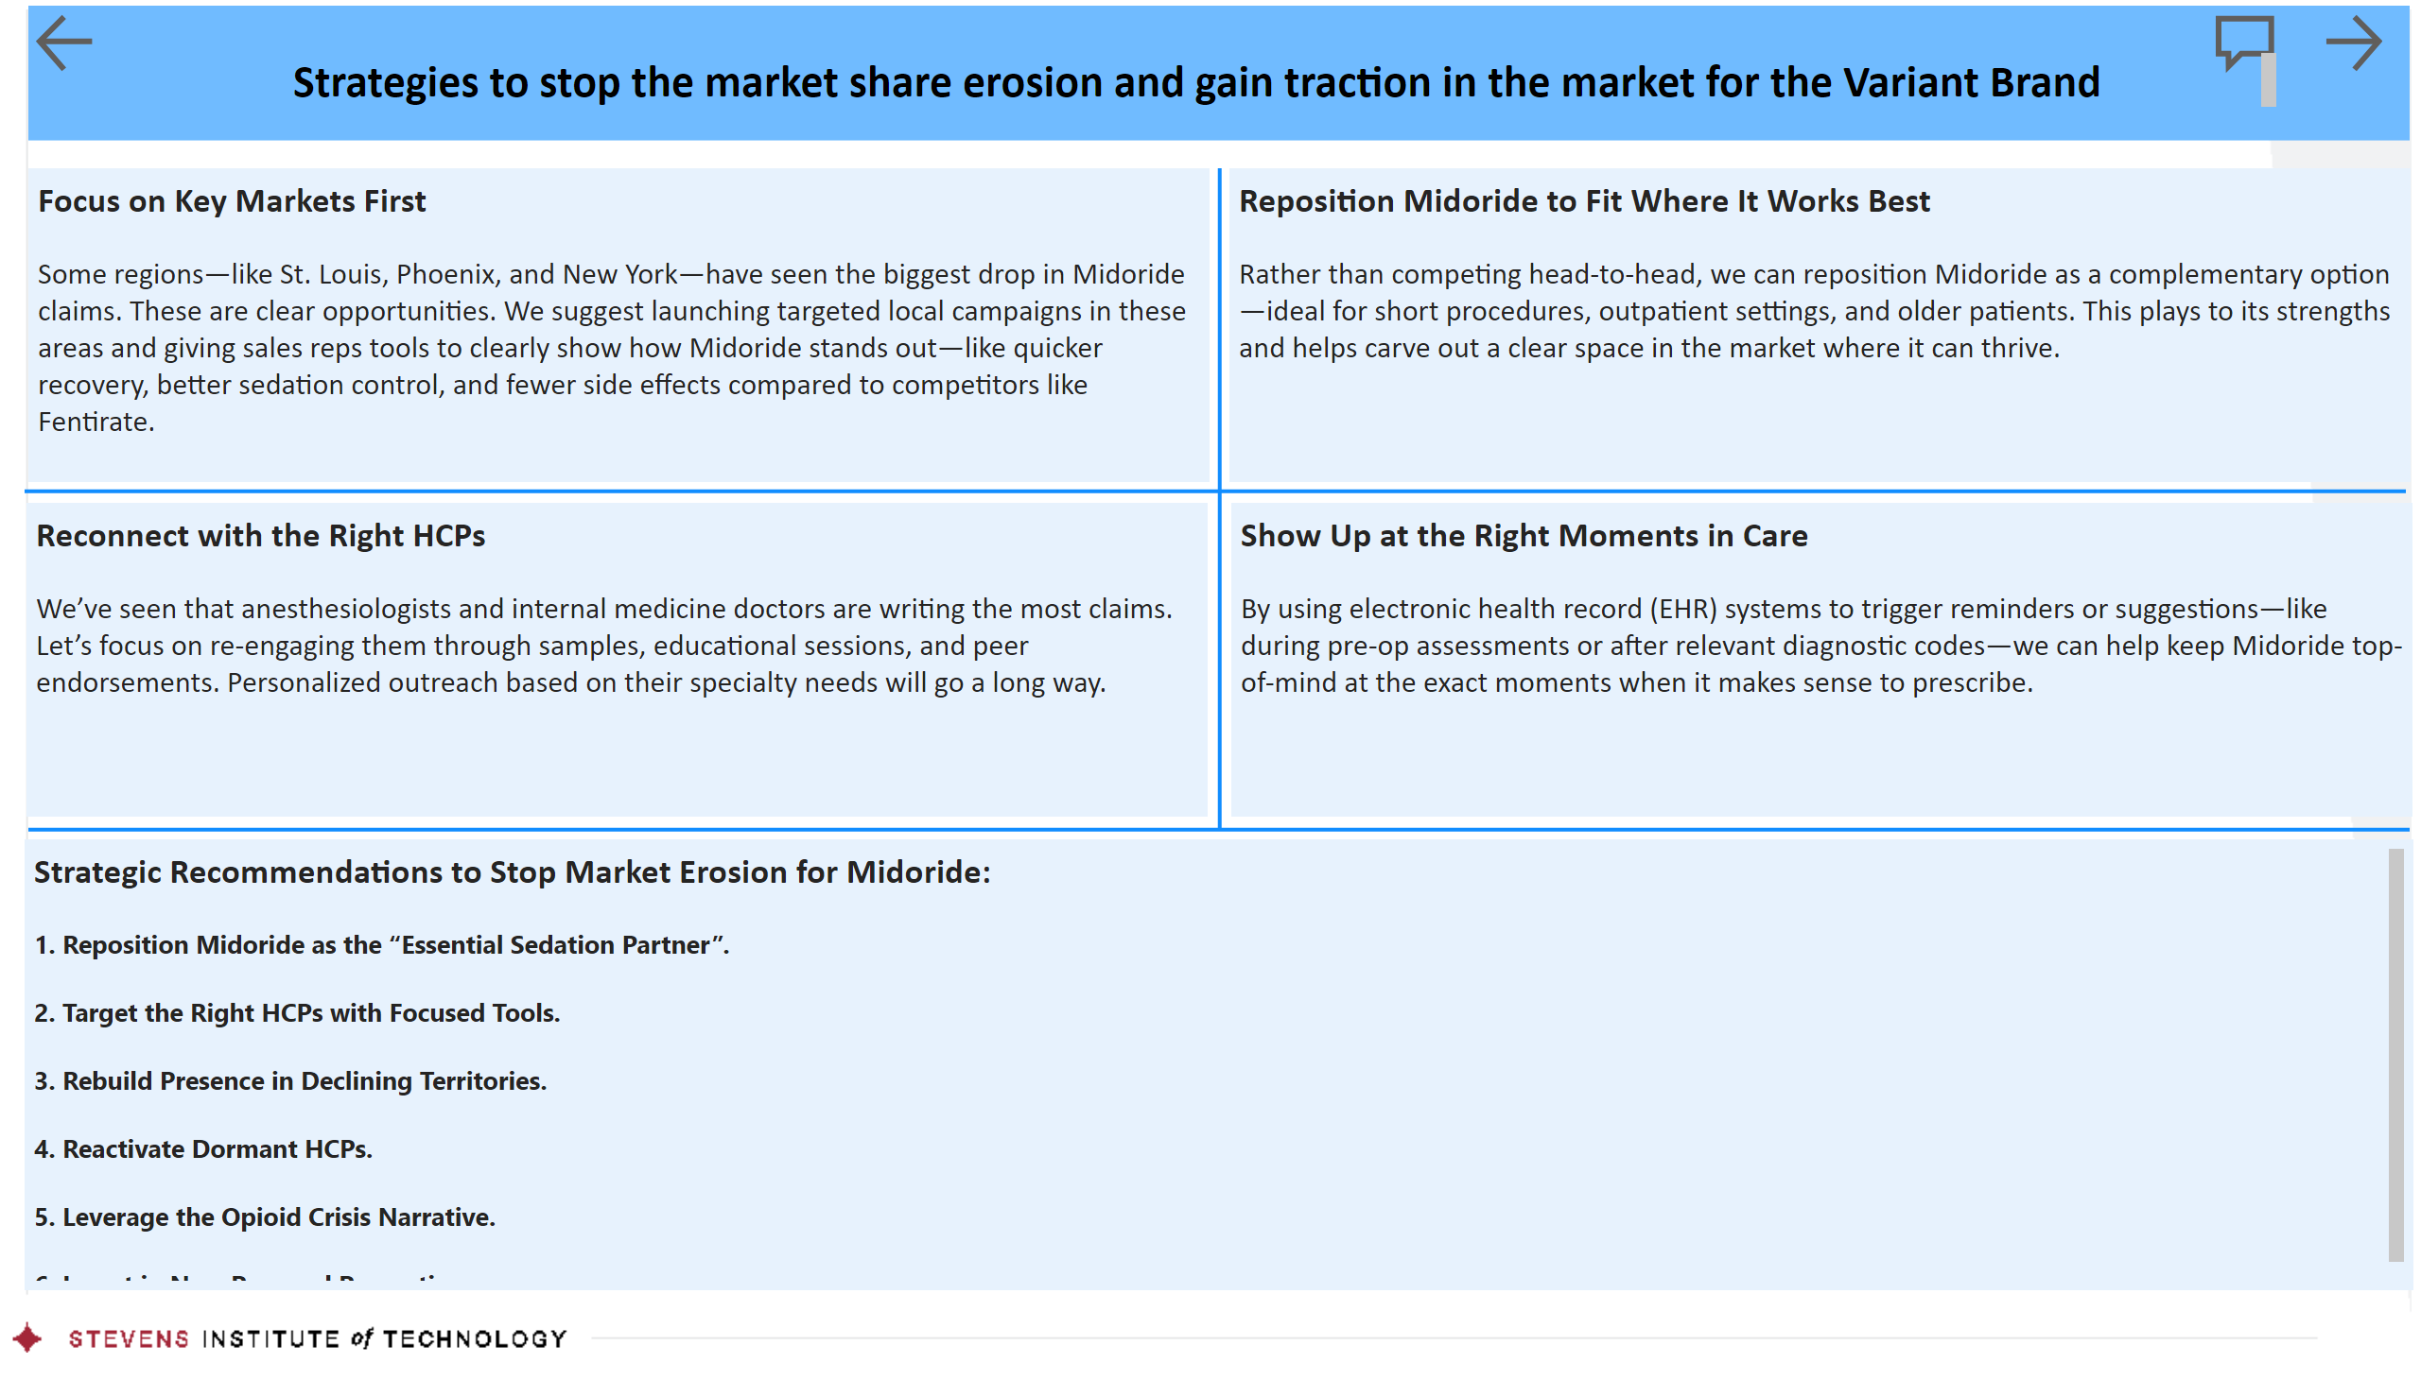
Market Summary
Notes:
actionButton
No alt text provided
textbox
No alt text provided
shape
No alt text provided
image
No alt text provided
actionButton
No alt text provided
actionButton
No alt text provided
textbox
No alt text provided
textbox
No alt text provided
textbox
No alt text provided
textbox
No alt text provided
shape
No alt text provided
shape
No alt text provided
shape
No alt text provided
textbox
No alt text provided

Slide 13
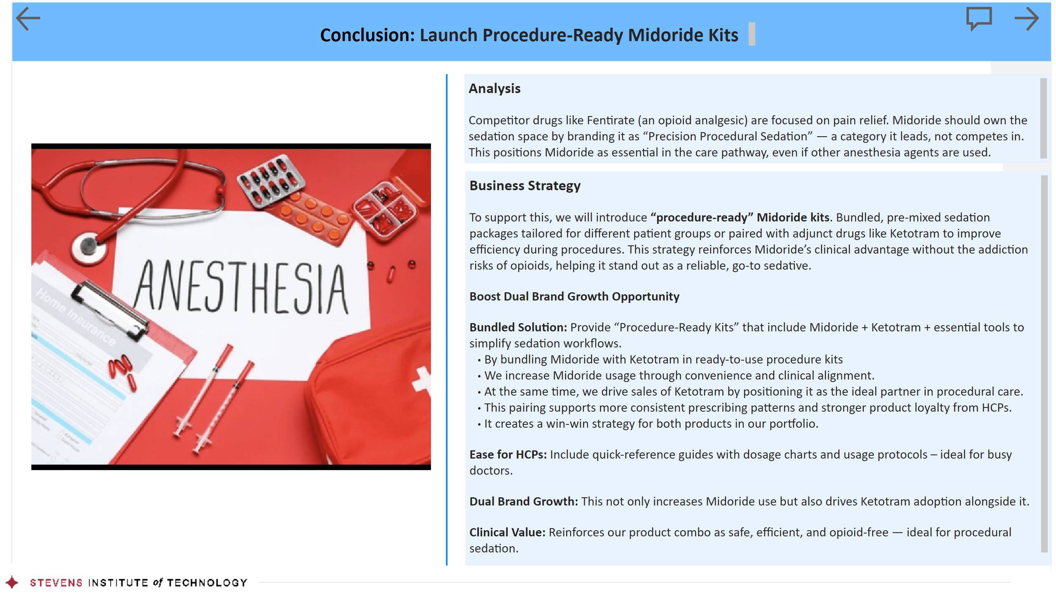
Conculsion
Notes:
actionButton
No alt text provided
textbox
No alt text provided
shape
No alt text provided
image
No alt text provided
actionButton
No alt text provided
actionButton
No alt text provided
textbox
No alt text provided
textbox
No alt text provided
shape
No alt text provided
image
No alt text provided

Slide 14

Thank You
Notes:
image
No alt text provided
actionButton
No alt text provided
actionButton
No alt text provided

Slide 15

Q&A
Notes:
image
No alt text provided
textbox
No alt text provided

